Slide 1
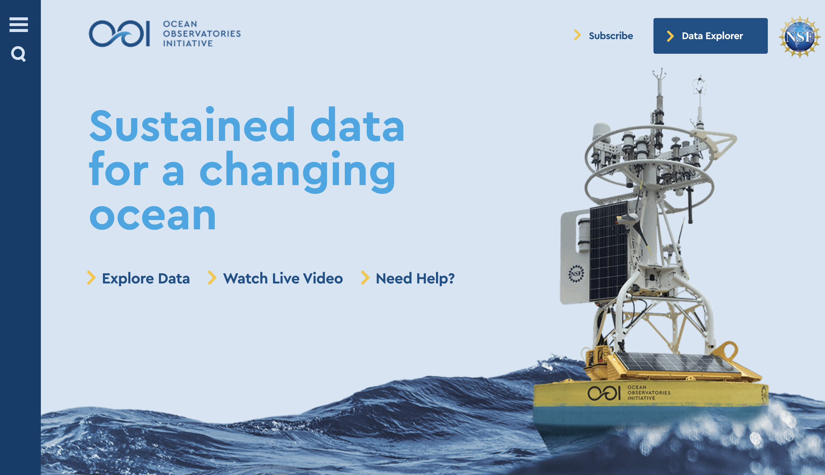
oceanobservatories.org
Click on “Data Explorer”
https://oceanobservatories.org/
Notes:
Structural elements: This is a walk through of how to get data from the OOI data base that are used for the introduction to the data analysis

Slide 2
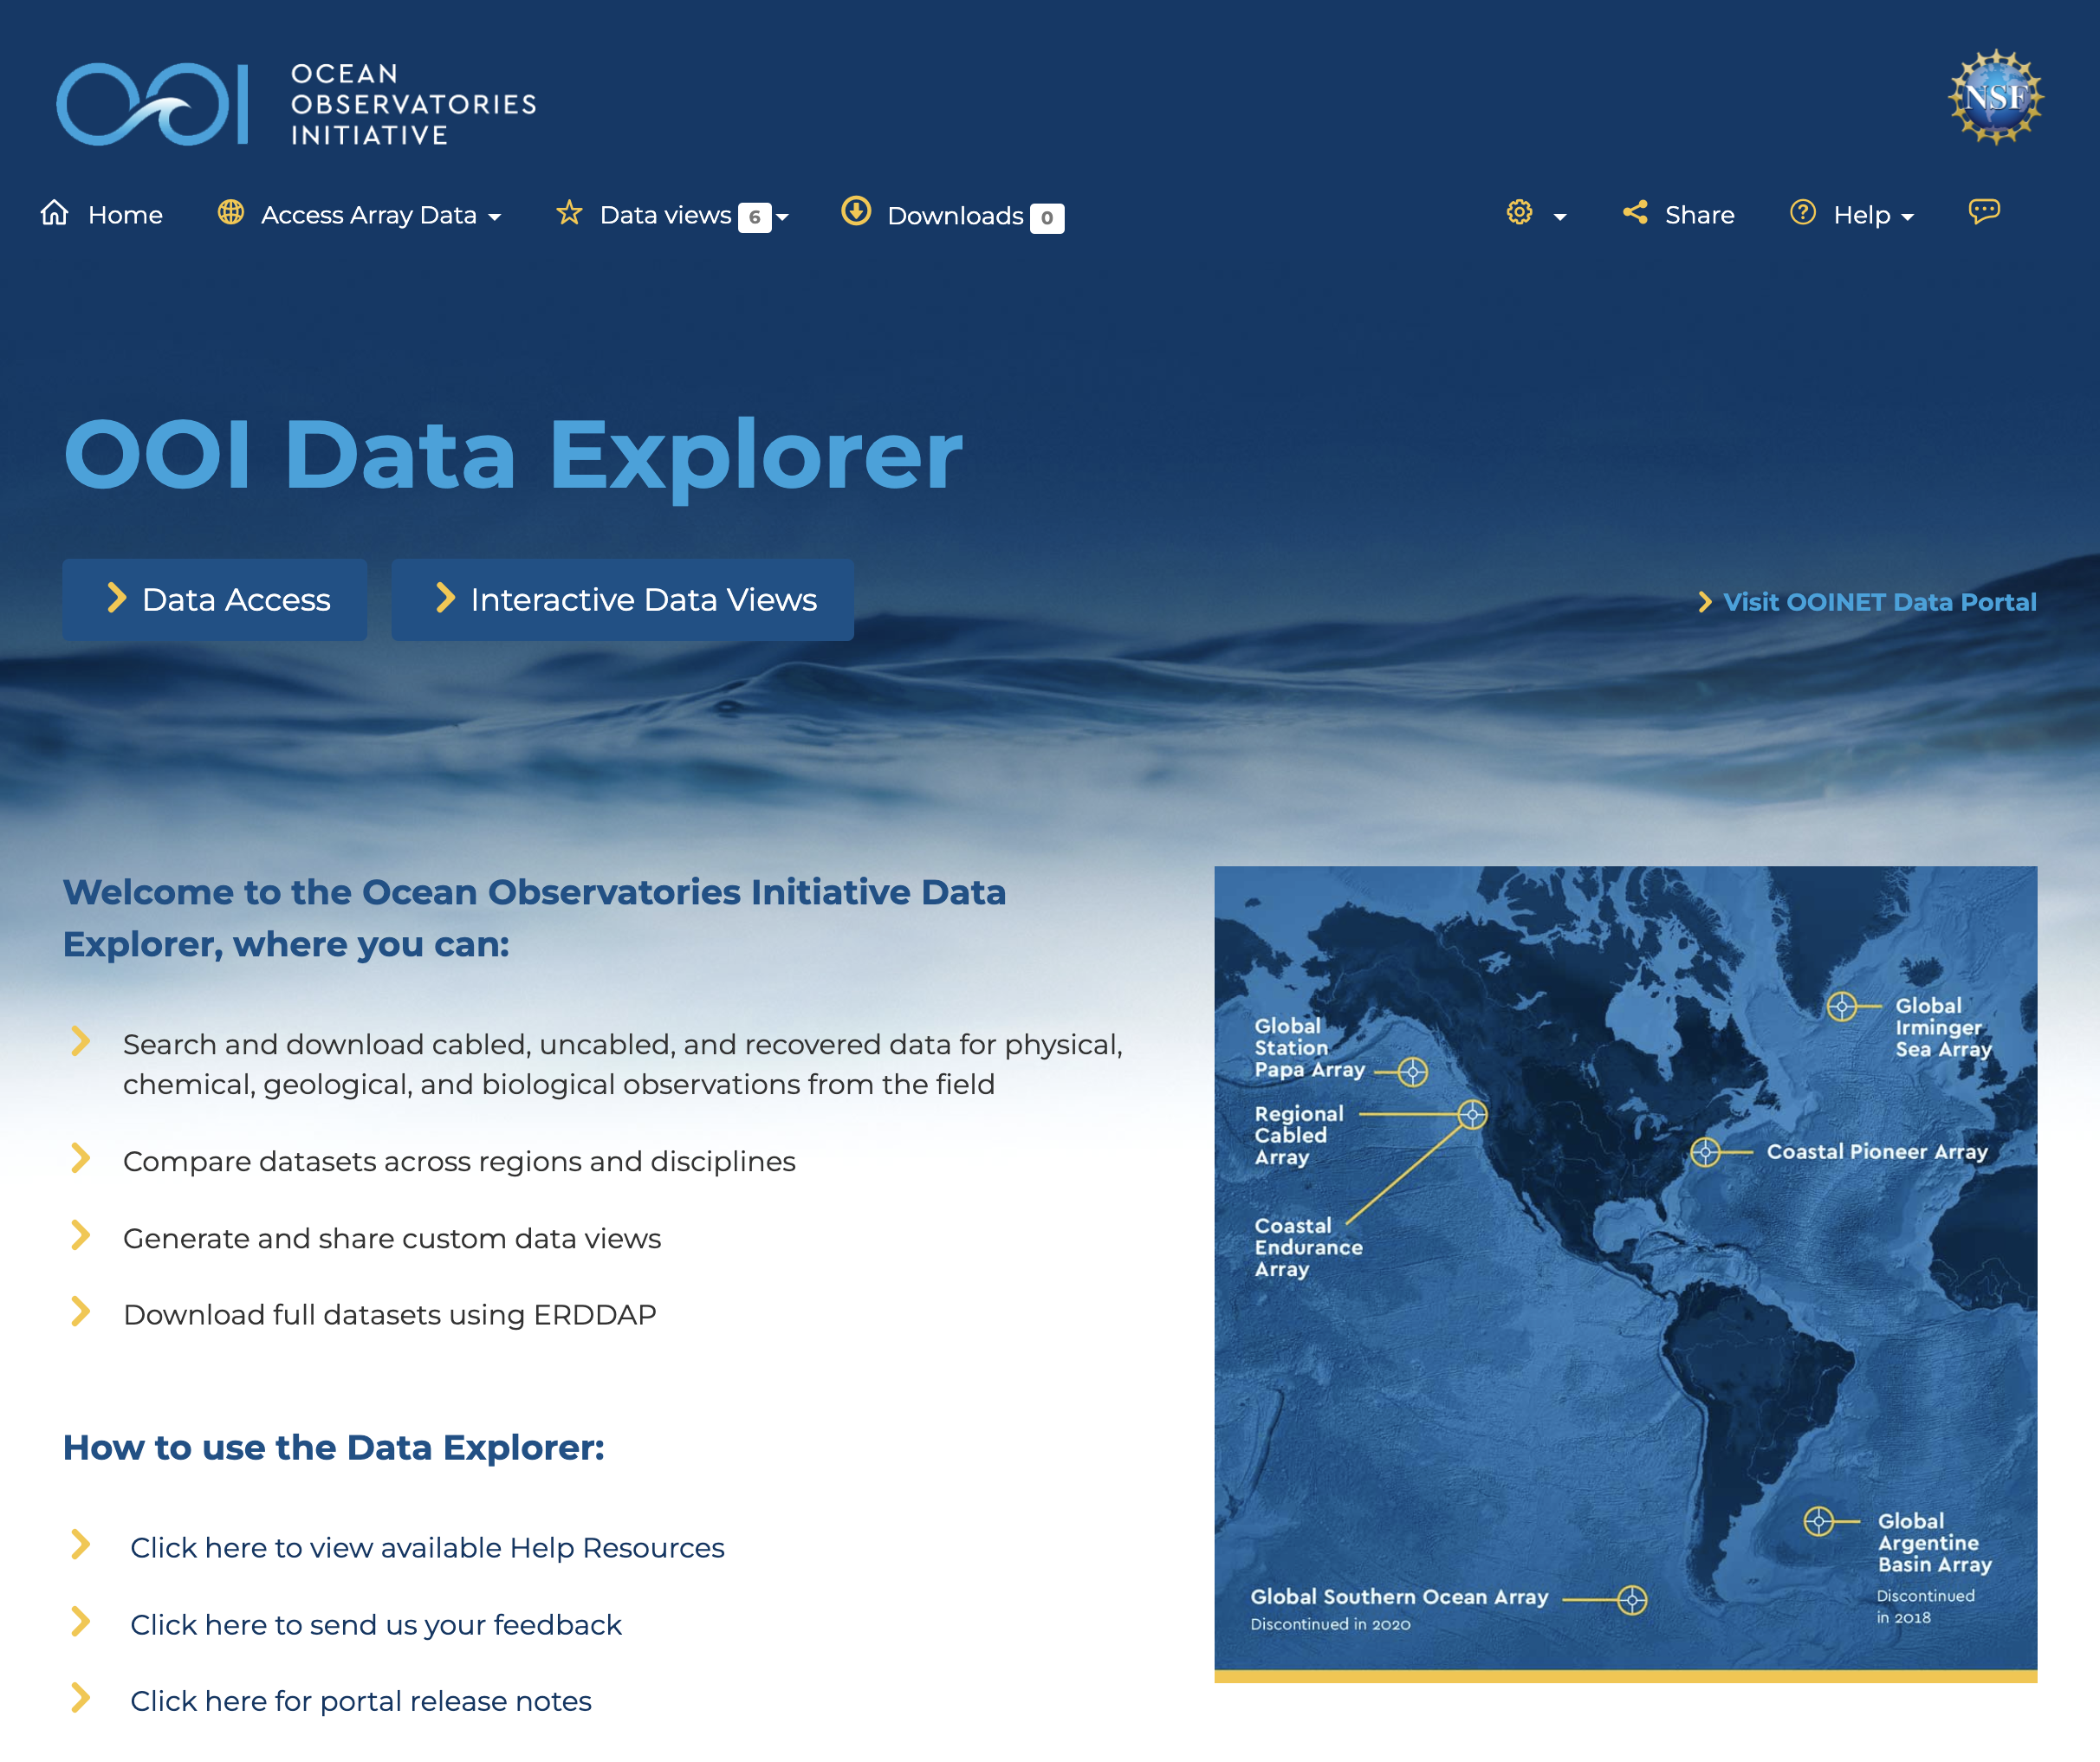
http://dataexplorer.oceanobservatories.org/
Scroll down to: Access and Explore Data

Slide 3
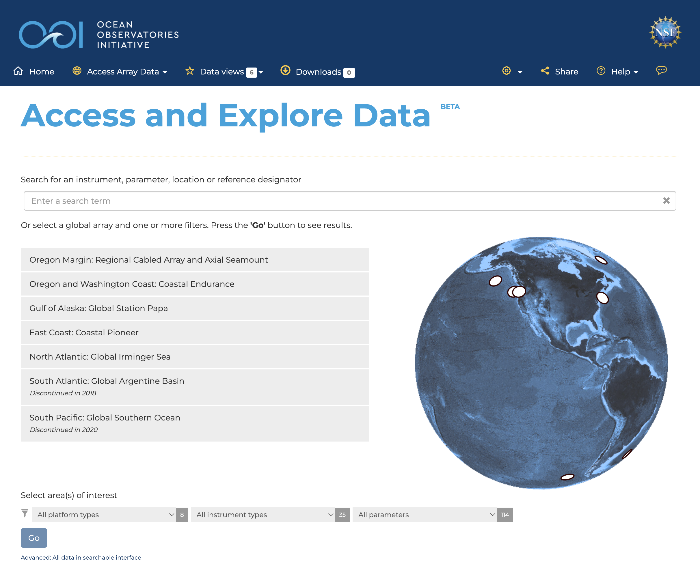
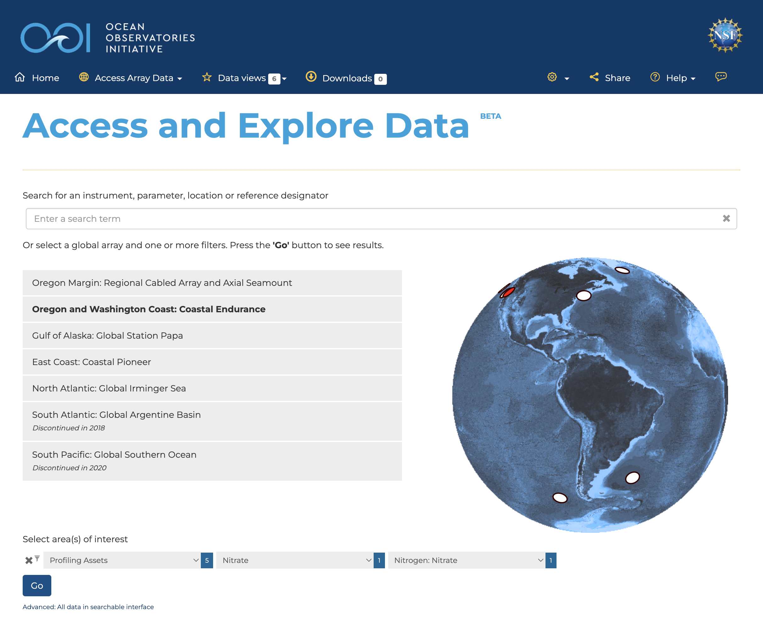
dataexplorer.oceanobservatories.org
Select: Oregon and Washington Coast: Coastal Endurance
Under: Select area(s) of interest
Select from pull down menus:
Profiling assets, Nitrate, Nitrogen: Nitrate

Slide 4
dataexplorer.oceanobservatories.org
Select: Oregon and Washington Coast: Coastal Endurance
Under: Select area(s) of interest
Select from pull down menus:
Profiling assets, Nitrate, Nitrogen: Nitrate
Click on “Go” button

Slide 5
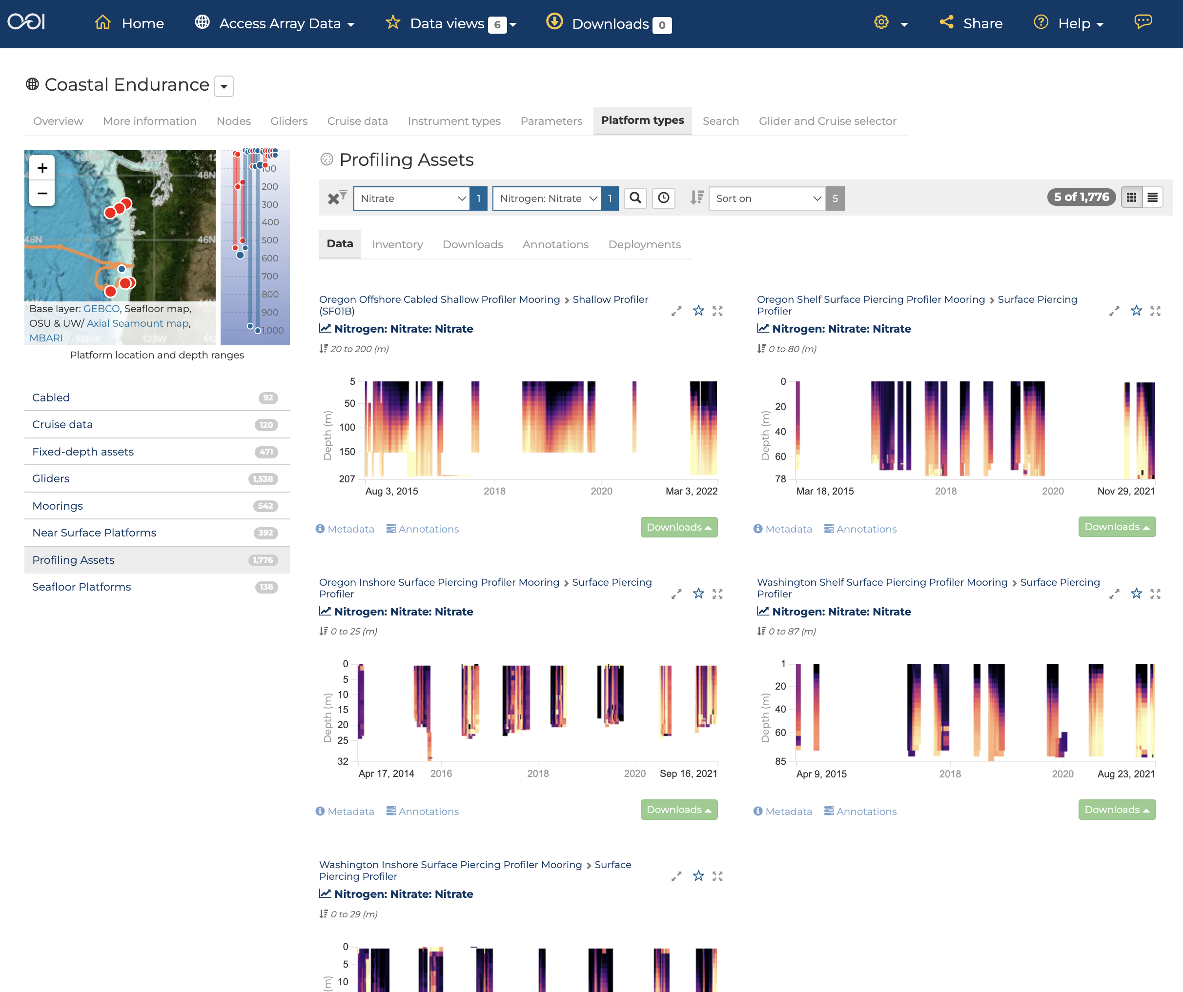
dataexplorer.oceanobservatories.org/#ooi/array/CE/platform_type/profiling-assets/data?instrument_type_id=NUTNR&parameter_id=124
To get an individual deployment data set, click on ‘Downloads’

Slide 6
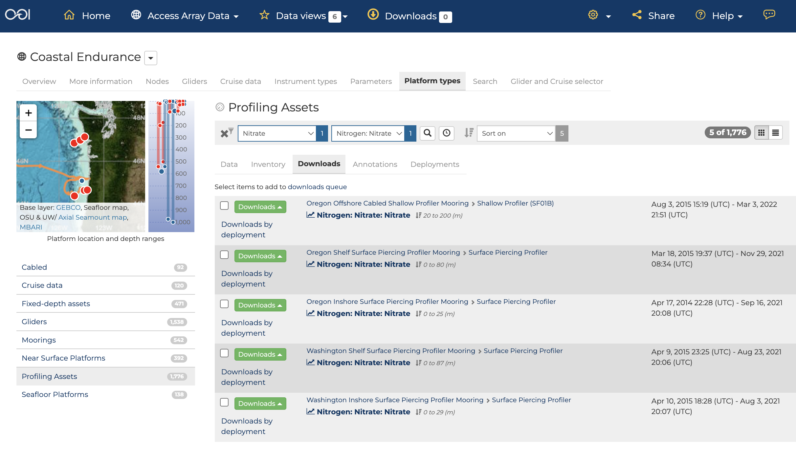
dataexplorer.oceanobservatories.org/#ooi/array/CE/platform_type/profiling-assets/downloads?instrument_type_id=NUTNR&parameter_id=124
Click on “Downloads by deployment” in the Shallow Profiler (SFO1B) box

Slide 7
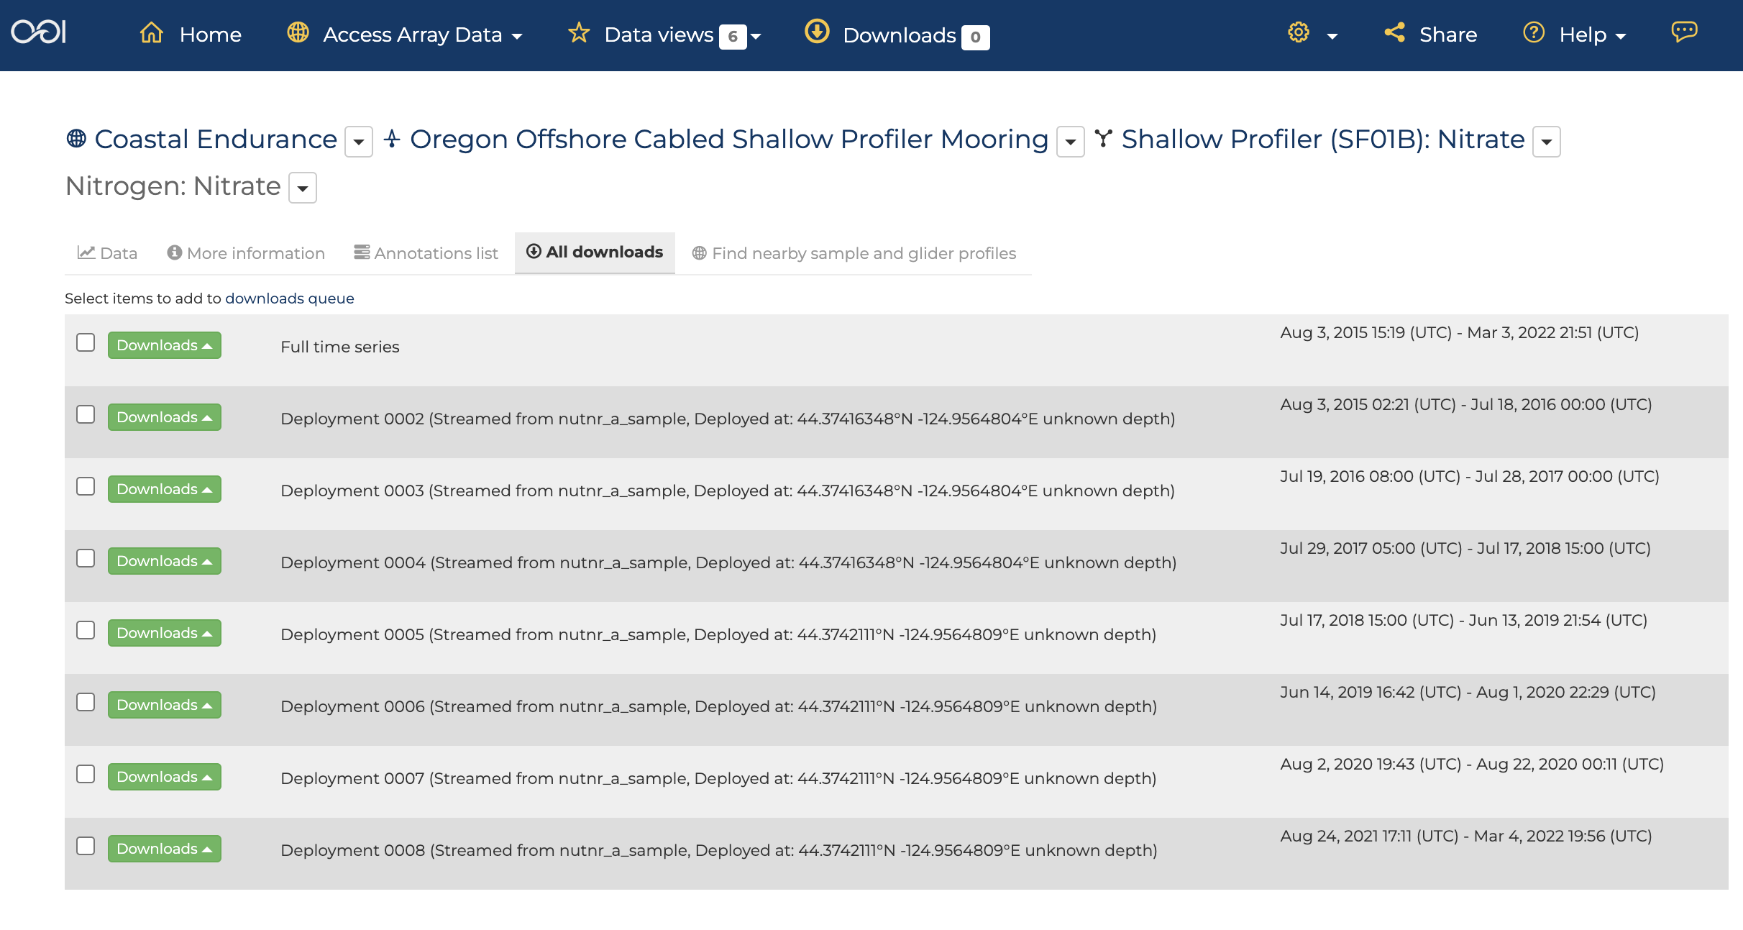
dataexplorer.oceanobservatories.org/#metadata/103775/station/124/sensor/downloads
Click on the ‘Downloads’ button for Deployment 0007

Slide 8
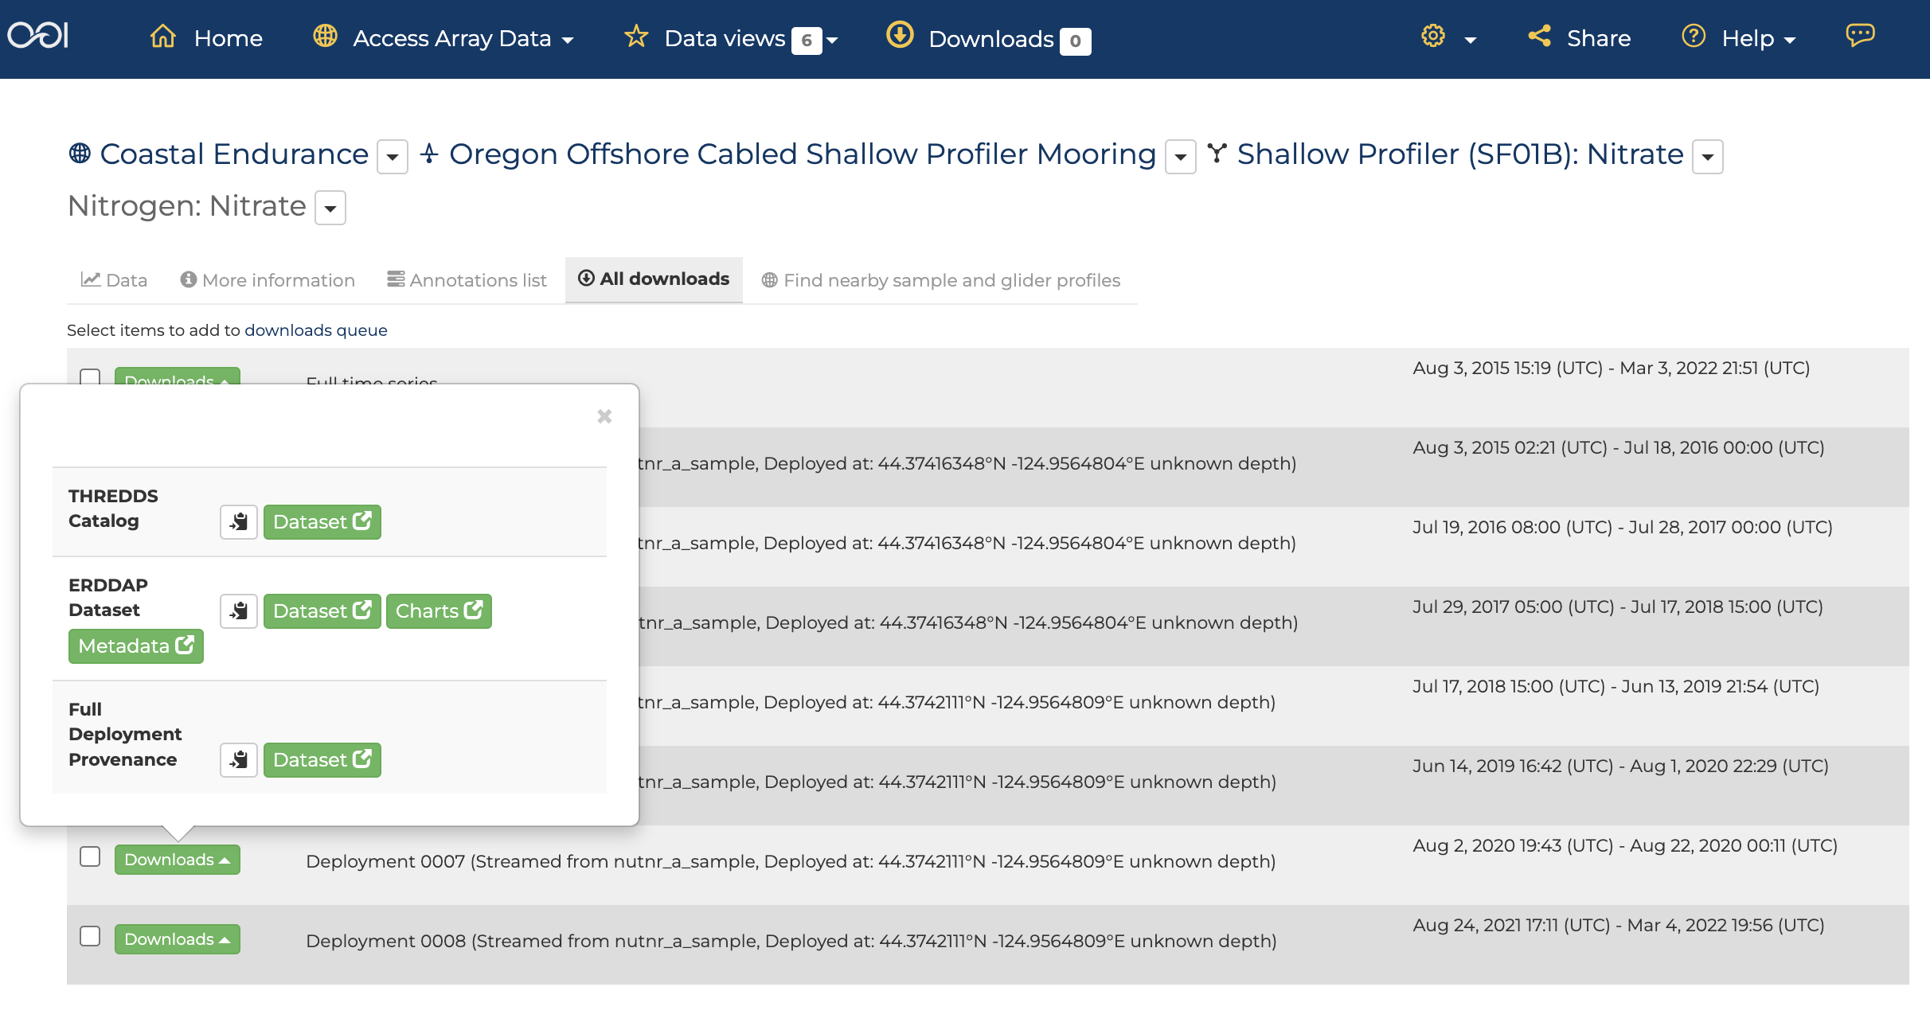
dataexplorer.oceanobservatories.org/#metadata/103775/station/124/sensor/downloads
, and then
http://erddap-goldcopy.dataexplorer.oceanobservatories.org/erddap/tabledap/CE04OSPS-SF01B-4A-NUTNRA102-nutnr_a_sample-streamed-deployment0007.html
Click on the ‘Downloads’ button for Deployment 0007

Slide 9
dataexplorer.oceanobservatories.org/#metadata/103775/station/124/sensor/downloads
Click on the ‘Dataset’ button to the right of the ERDDAP line in the popup window”

Slide 10
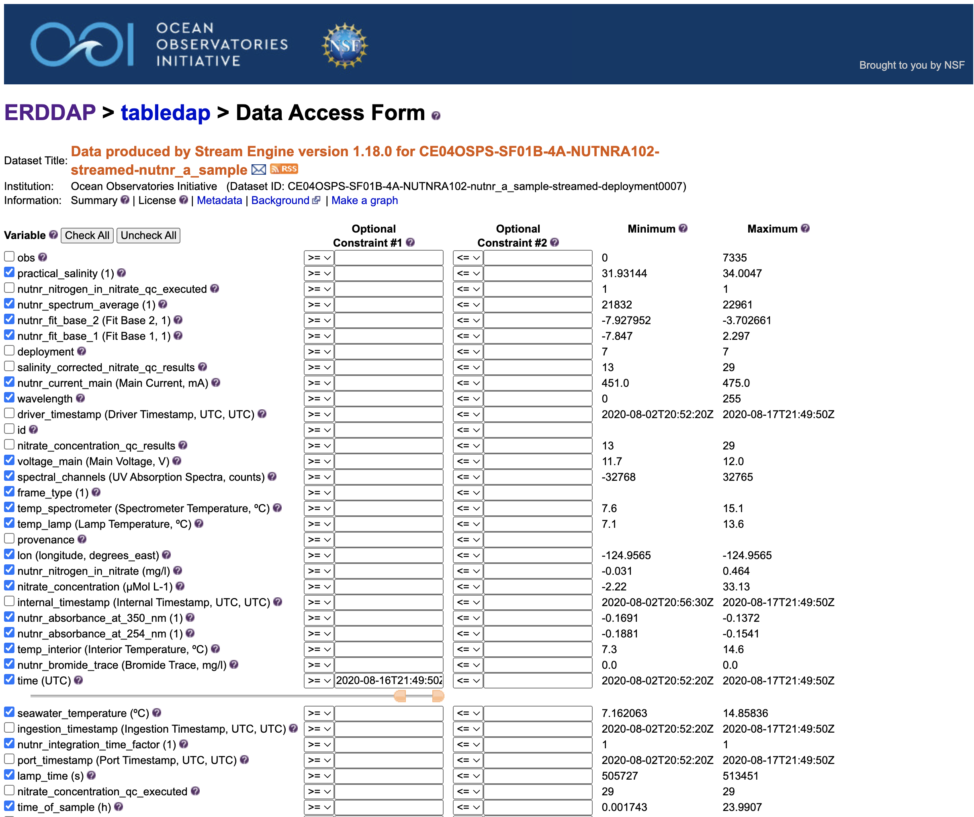
http://erddap-goldcopy.dataexplorer.oceanobservatories.org/erddap/tabledap/CE04OSPS-SF01B-4A-NUTNRA102-nutnr_a_sample-streamed-deployment0007.html
Click on the ‘Uncheck All’ button to clear the menu

Slide 11
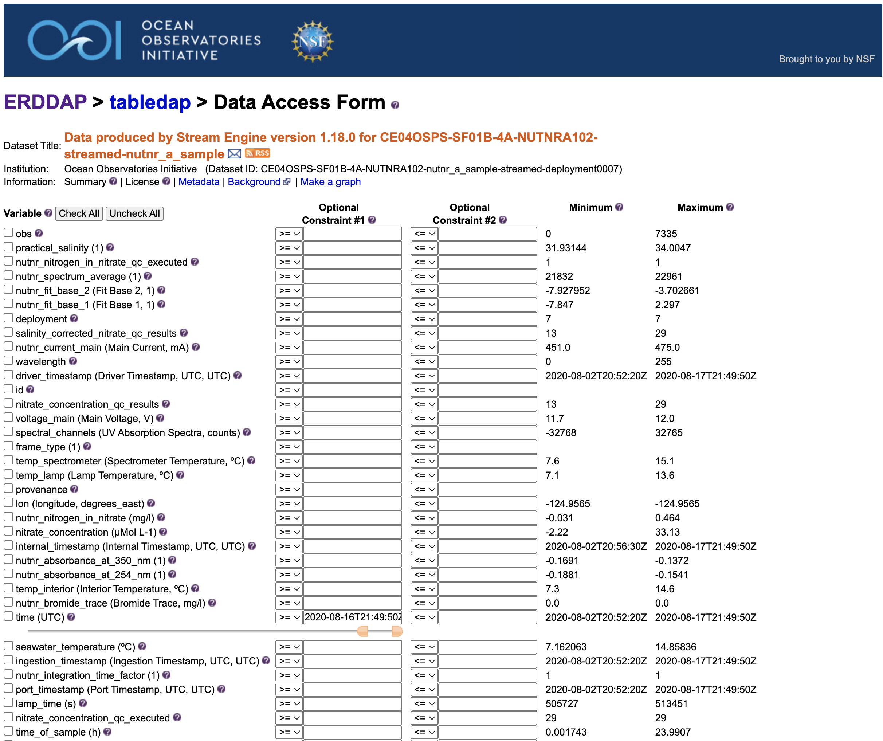
http://erddap-goldcopy.dataexplorer.oceanobservatories.org/erddap/tabledap/CE04OSPS-SF01B-4A-NUTNRA102-nutnr_a_sample-streamed-deployment0007.html
Select the variables that you want to download by clicking in the check boxes to the left of the variable.

Slide 12
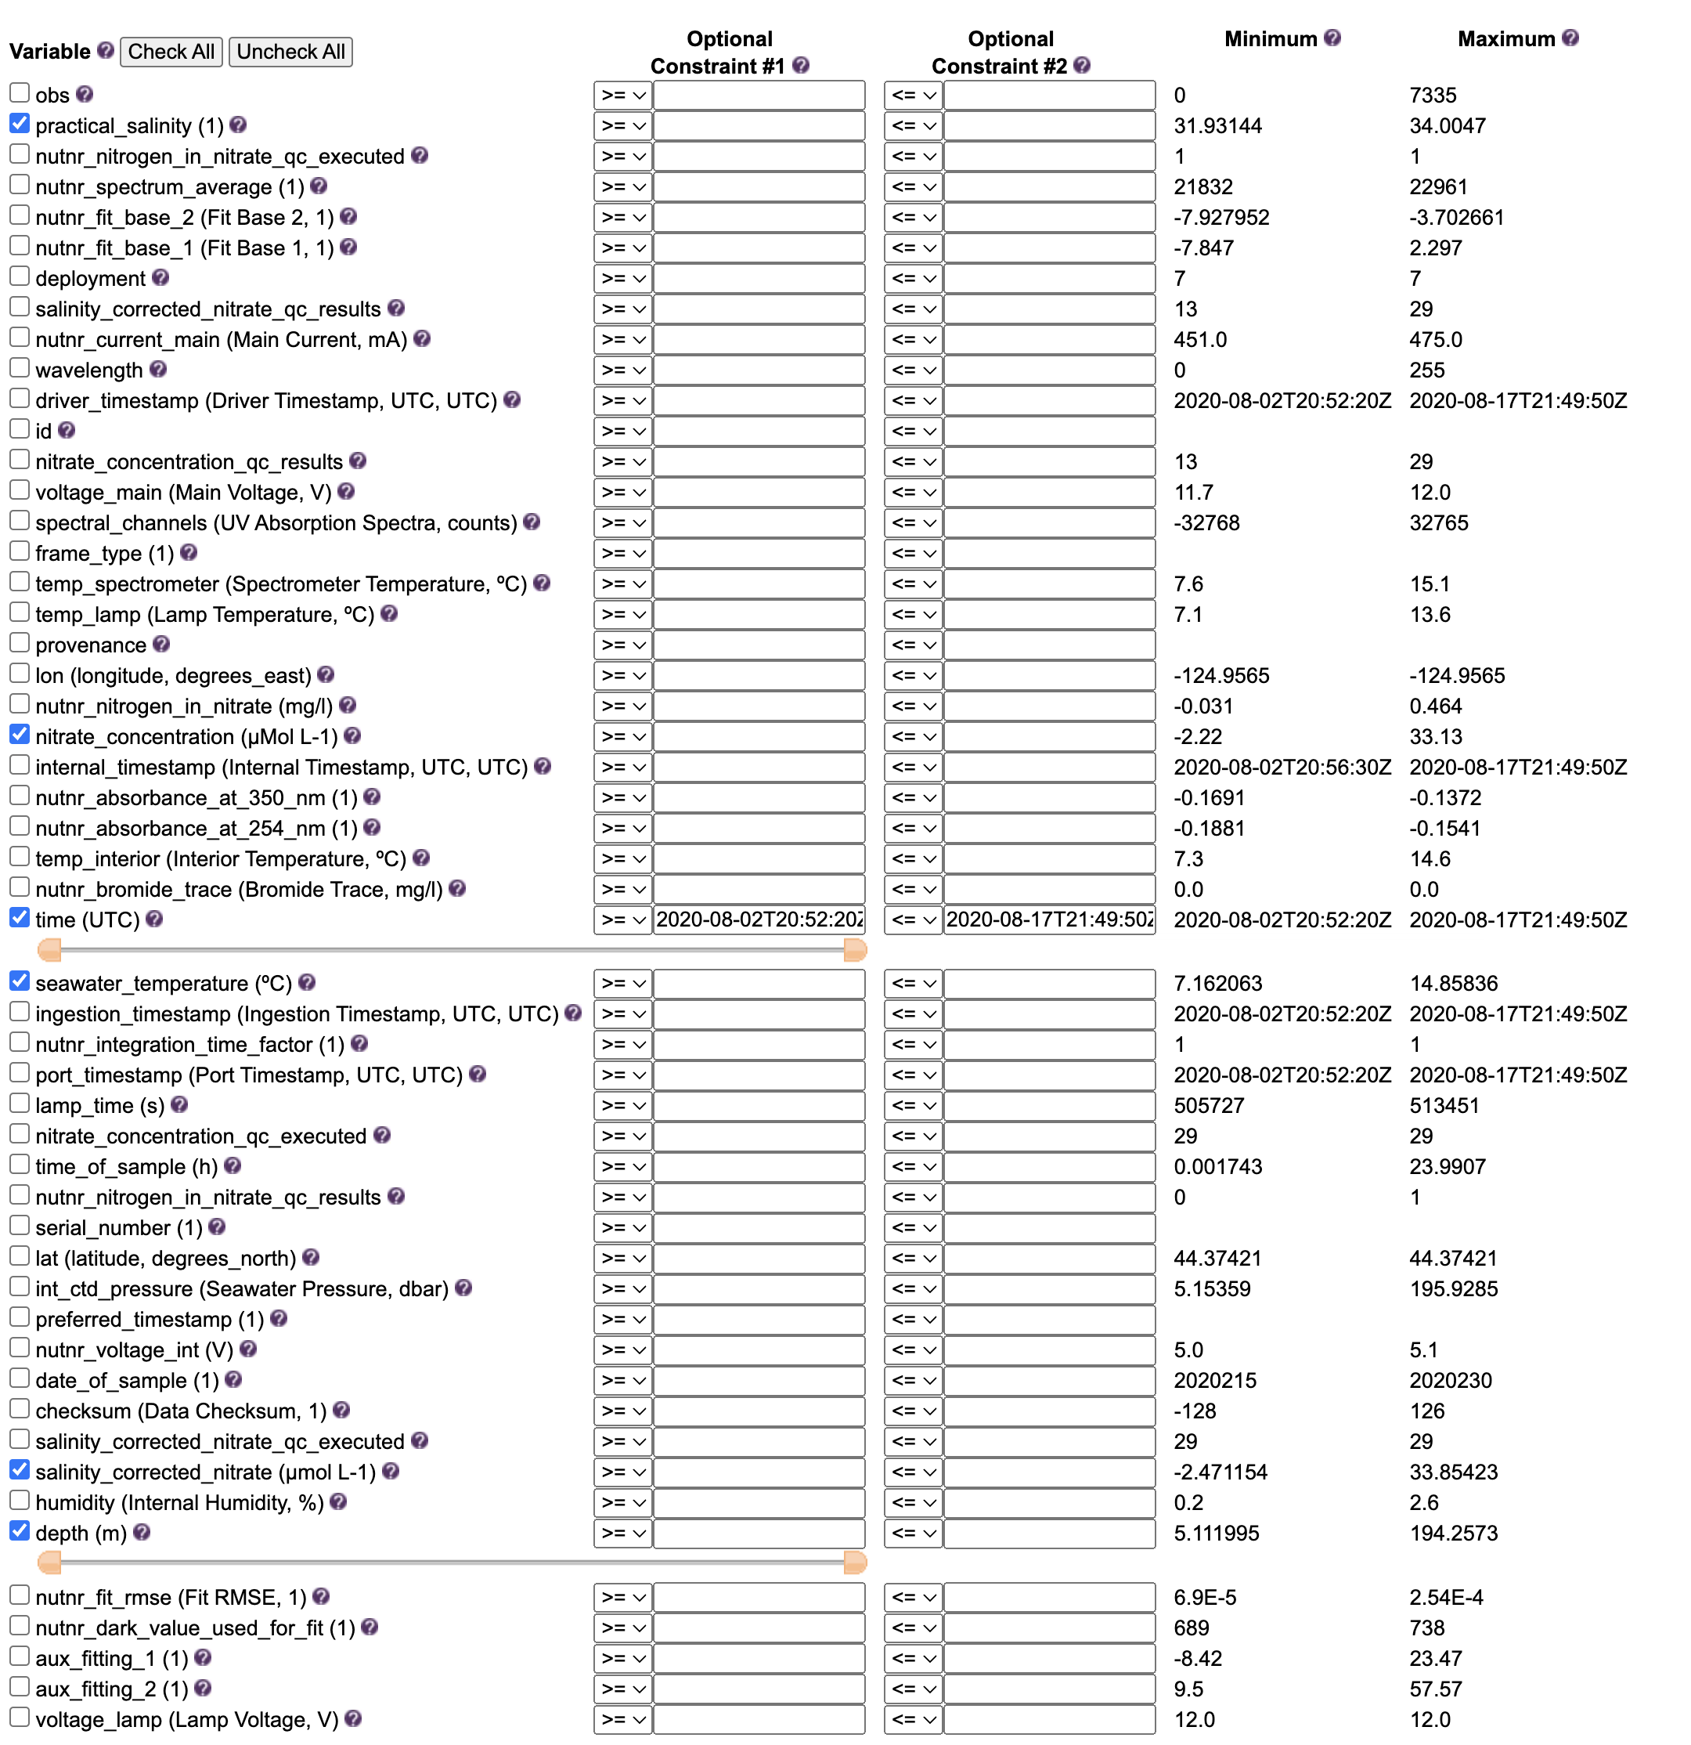
http://erddap-goldcopy.dataexplorer.oceanobservatories.org/erddap/tabledap/CE04OSPS-SF01B-4A-NUTNRA102-nutnr_a_sample-streamed-deployment0007.html
For this exercise we want:
water mass data;
salinity
temperature
uncorrected nitrate concentration in moles
salinity corrected nitrate
Sample depth
Profile time
Set the start time to the beginning of the deployment by moving the left hand slider all the way to the left. Set the end time to the end of the deployment by moving the right hand slider all the way to the right. The times displayed in the optional constraint boxes should match the values in the minimum and maximum columns.

Slide 13
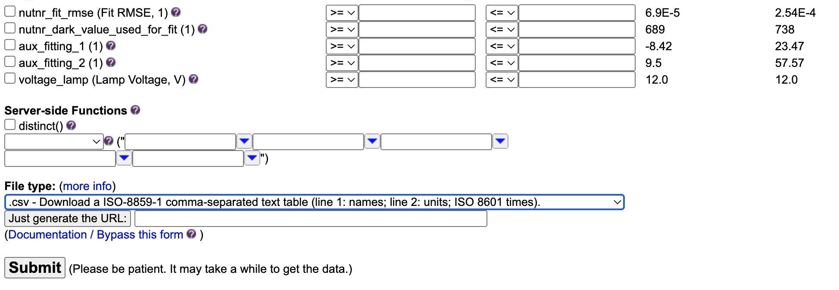
http://erddap-goldcopy.dataexplorer.oceanobservatories.org/erddap/tabledap/CE04OSPS-SF01B-4A-NUTNRA102-nutnr_a_sample-streamed-deployment0007.html
Chose the file type you want from the pull down menu, in this case a .csv file
Then select ‘Submit’ and the download should begin.
Here is the name of the file generated:
CE04OSPS-SF01B-4A-NUTNRA102-nutnr_a_sample-streamed-deployment0007_eaef_624d_69e0.csv

Slide 14
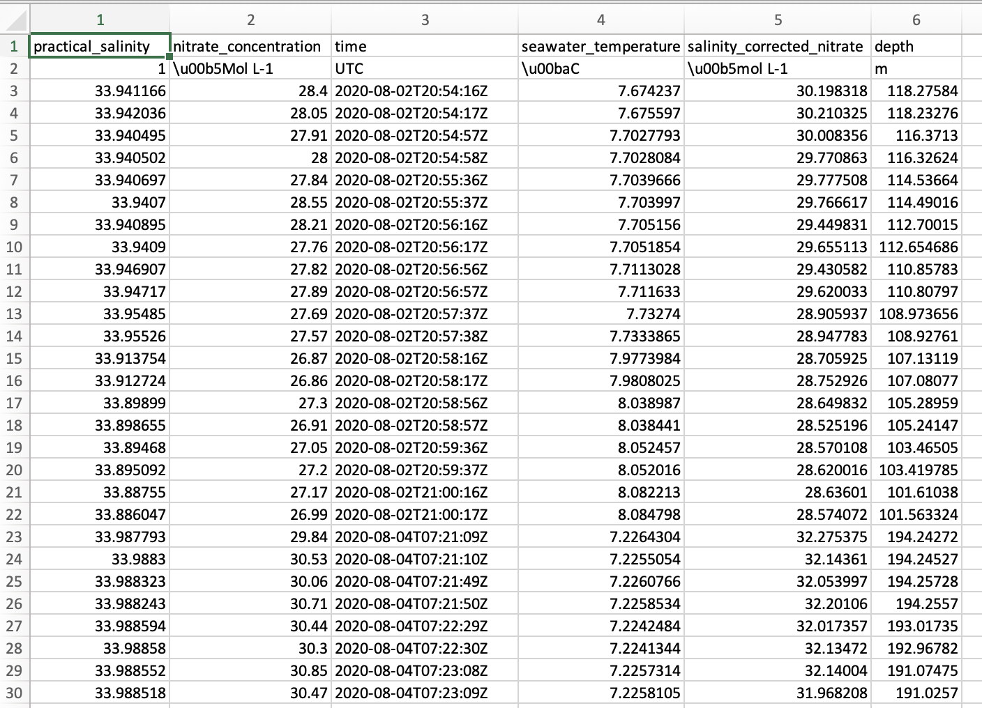
CE04OSPS-SF01B-4A-NUTNRA102-nutnr_a_sample-streamed-deployment0007_eaef_624d_69e0.csv
Here is the resultant file after opening it in Excel:

Slide 15
Get Bottle Data for comparison and calibration check
Return to deployment download selection list: dataexplorer.oceanobservatories.org/#metadata/103775/station/124/sensor/downloads
Click on the ‘Find nearby sample and glider profiles’ button

Slide 16
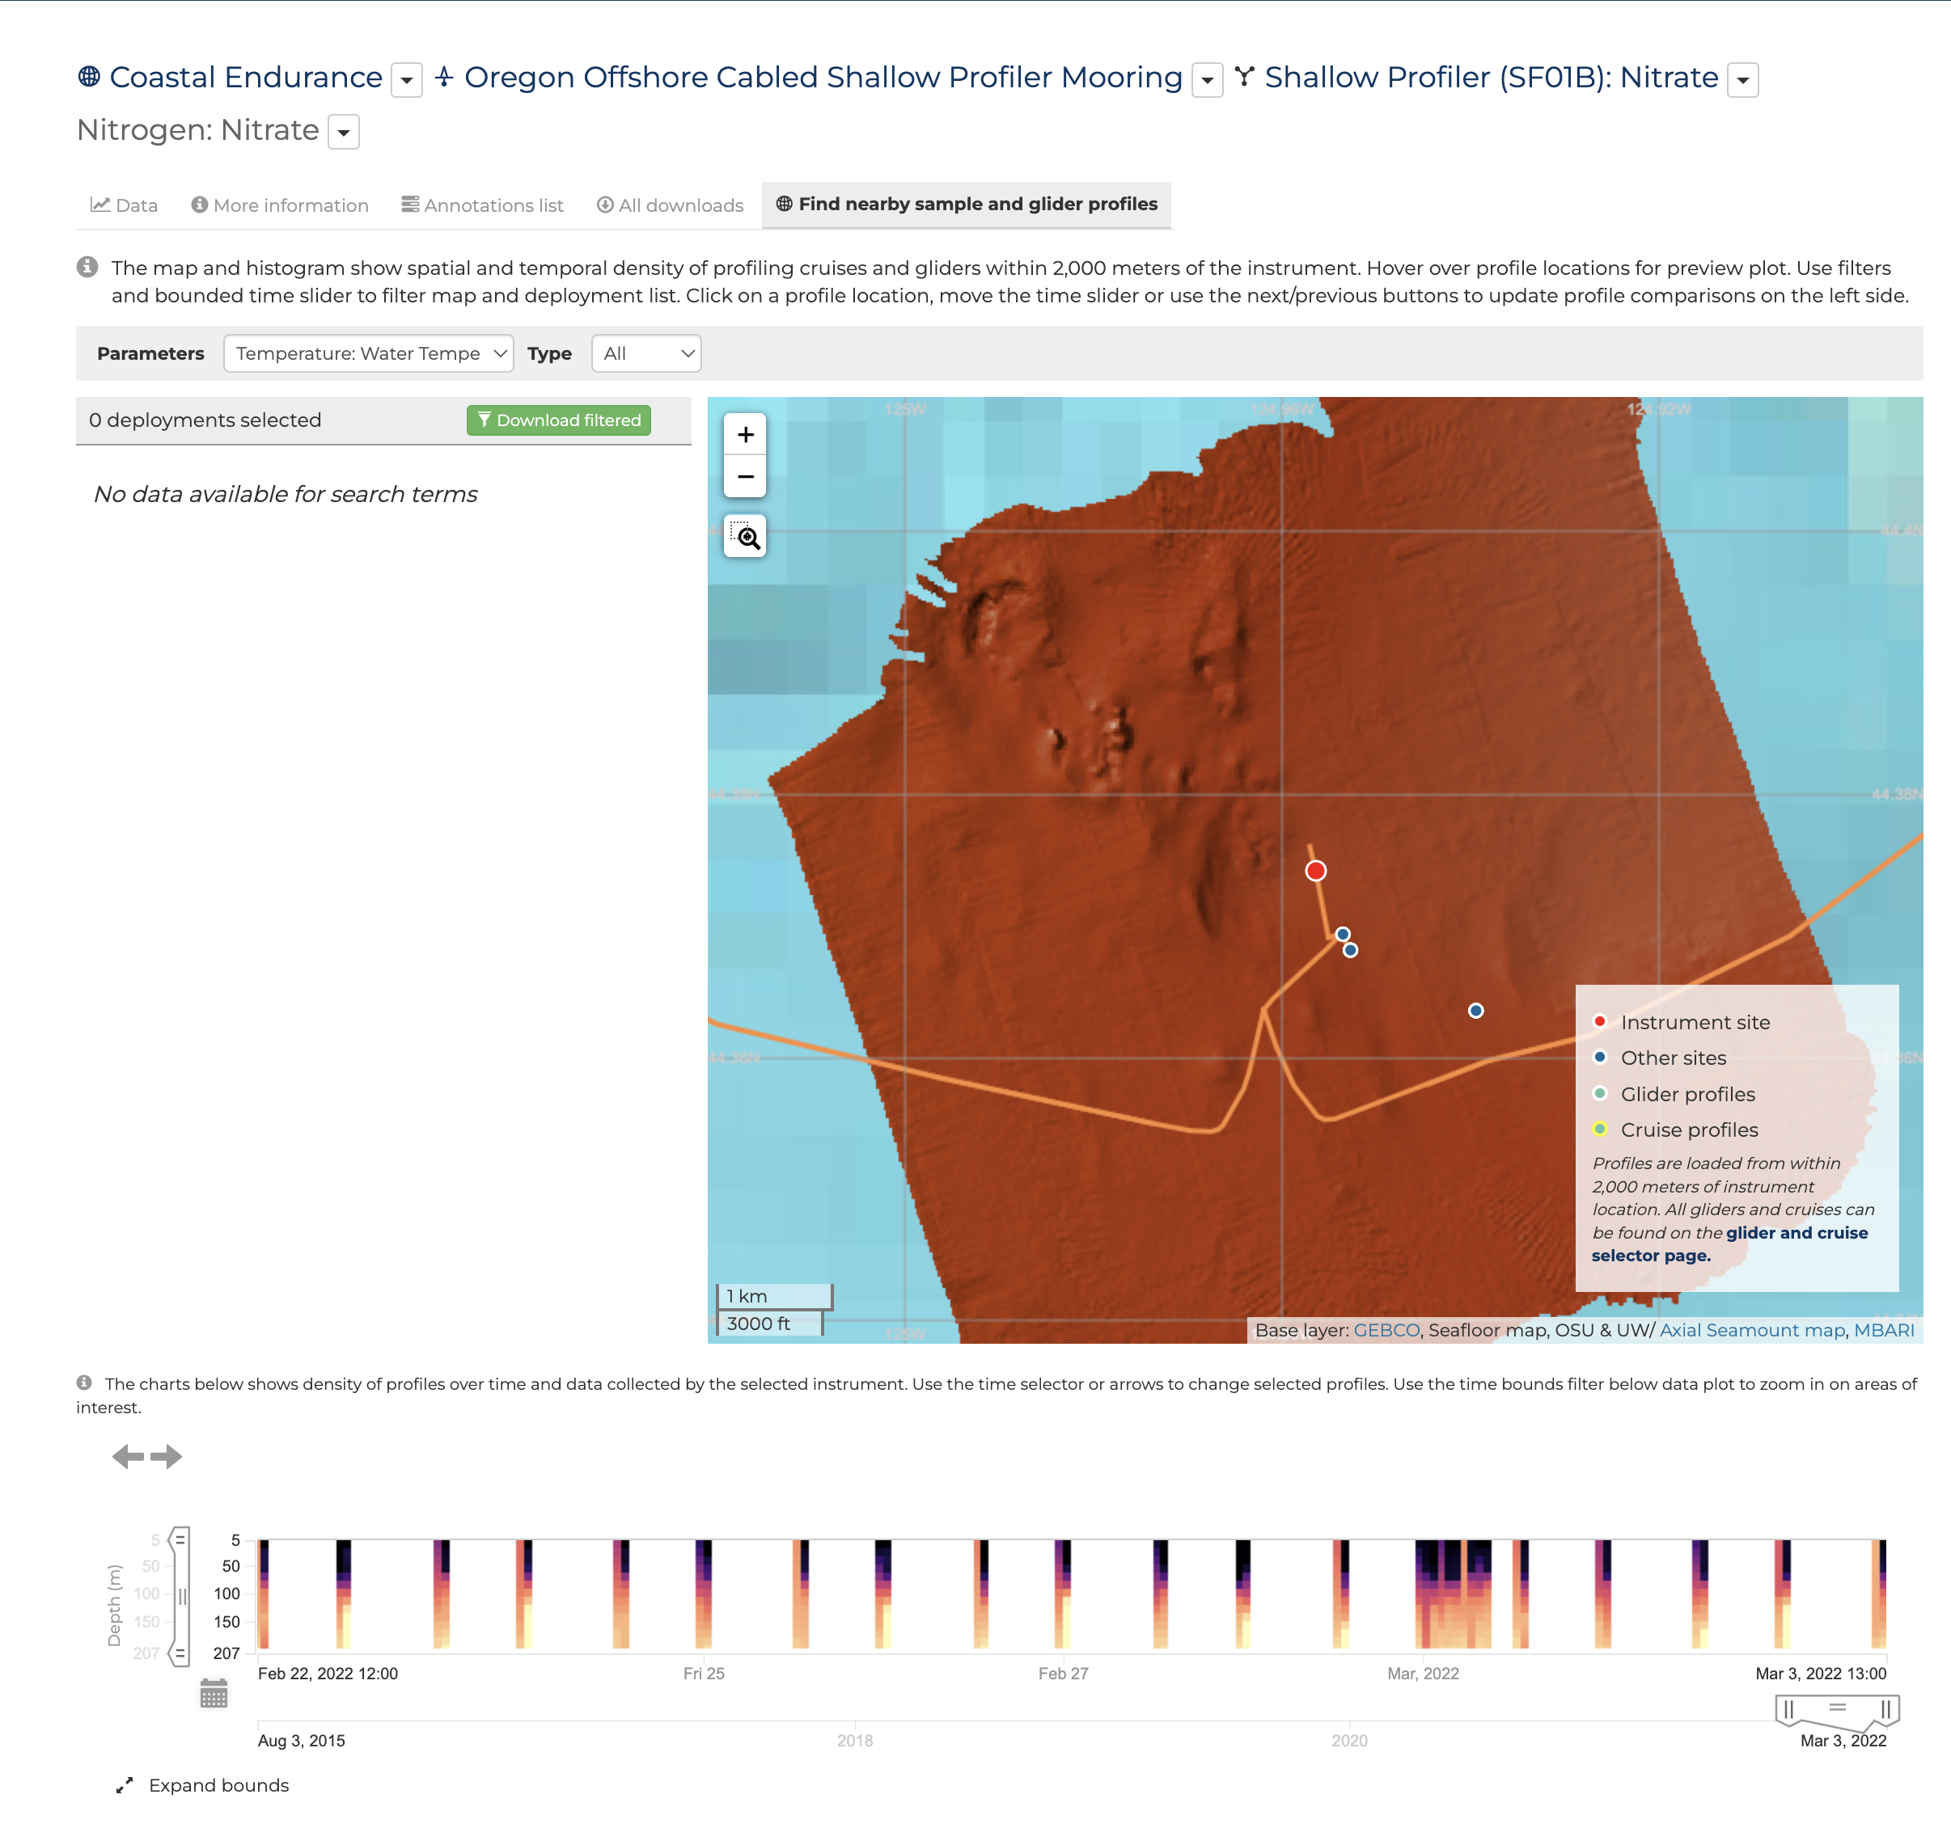
dataexplorer.oceanobservatories.org/#metadata/103775/station/124/sensor/profile_search
Select ‘Cruises’ in the Type pulldown menu
Location of the profiler mooring.

Slide 17
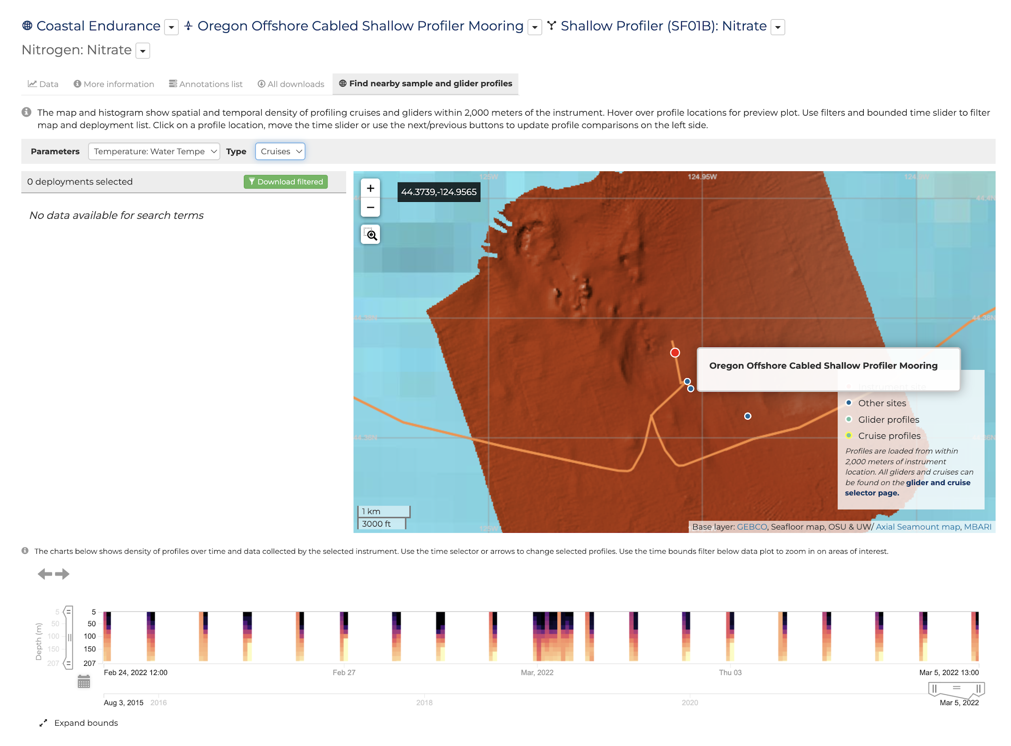
dataexplorer.oceanobservatories.org/#metadata/103775/station/124/sensor/profile_search
Hover the pointer over the profiler location and pop up windows display the coordinates and asset name.

Slide 18
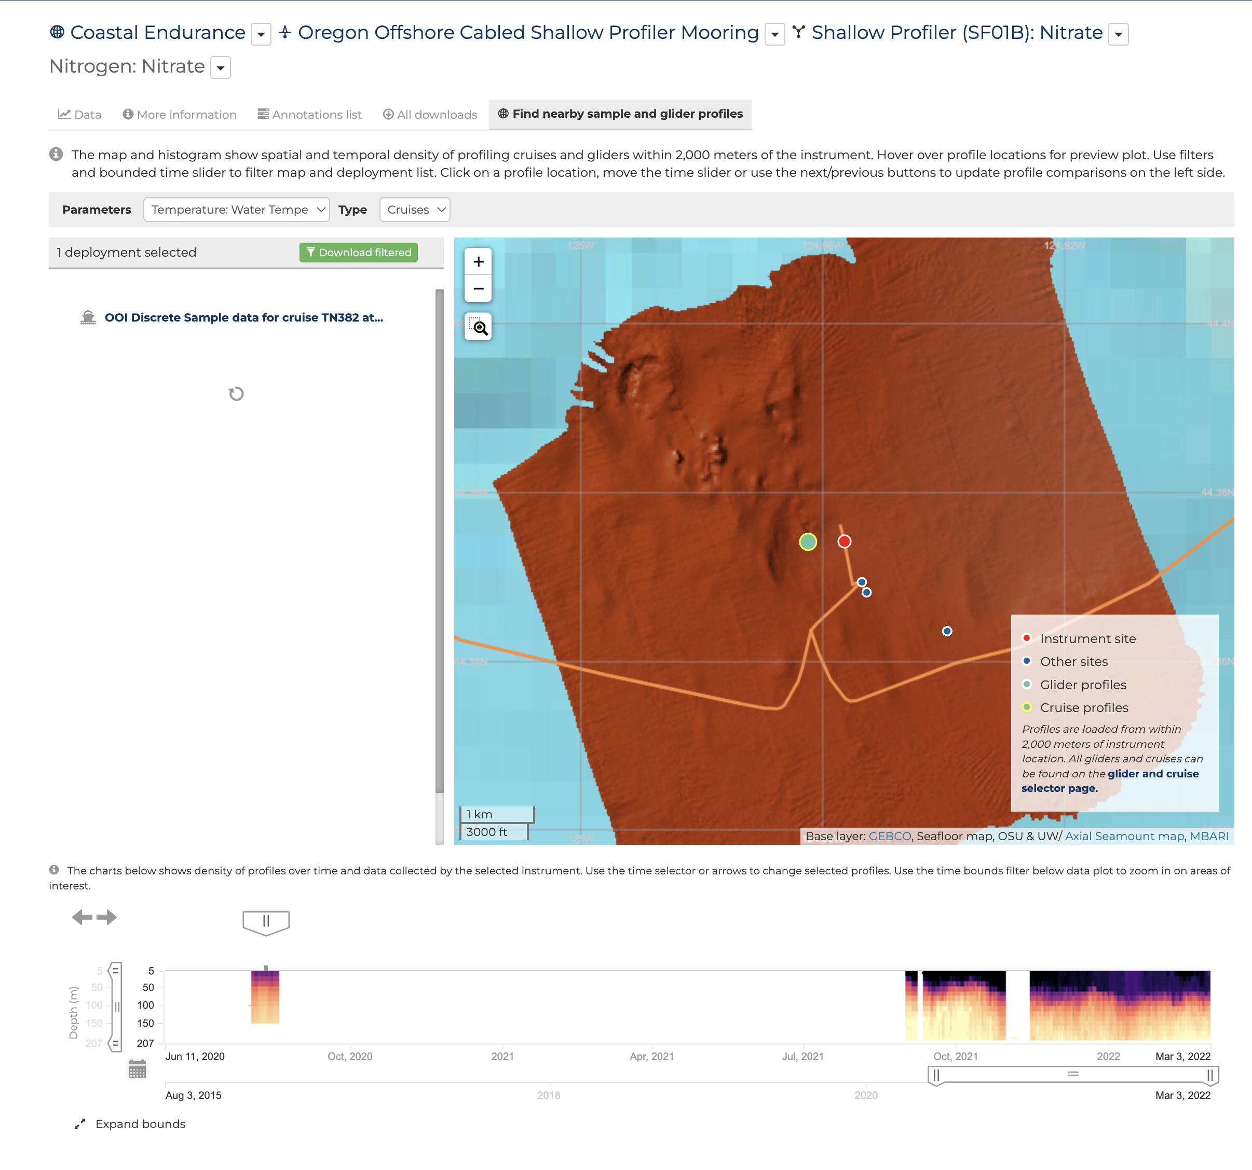
dataexplorer.oceanobservatories.org/#metadata/103775/station/124/sensor/profile_search
The specific cruise name shows up in the deployment selected area.
Location of the bottle data profile to the west of the moored profiler.
Move the left hand slider to the left until the July/August 2020 profiles show in the data availability bar.
The July/August 2020 profiles

Slide 19
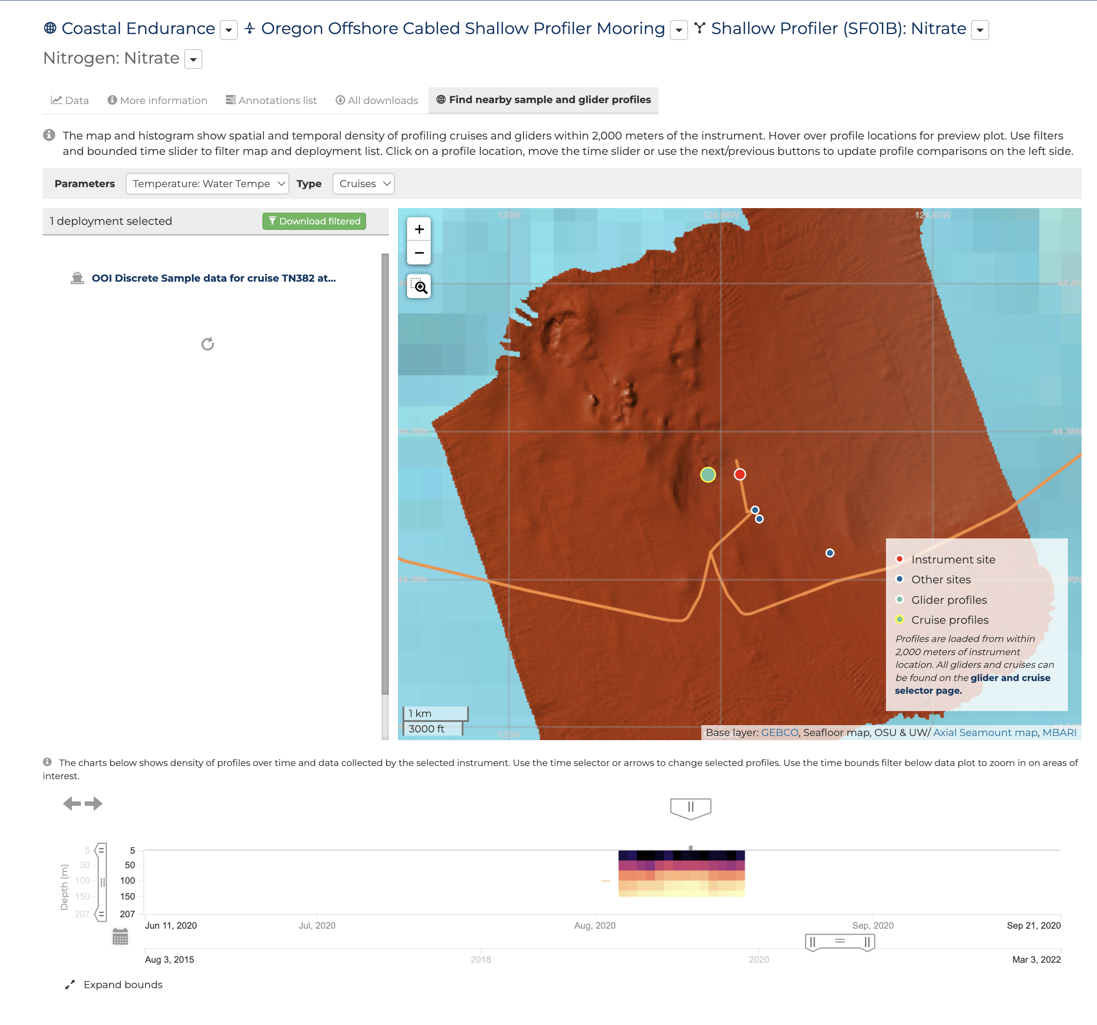
dataexplorer.oceanobservatories.org/#metadata/103775/station/124/sensor/profile_search
The specific cruise name shows up in the deployment selected area.
Move the right hand slider to exclude more recent data.
The July/August 2020 profiles.

Slide 20
dataexplorer.oceanobservatories.org/#metadata/103775/station/124/sensor/profile_search
Click on the ‘download filtered’ button and a popup box with the menu of download versions appears.

Slide 21
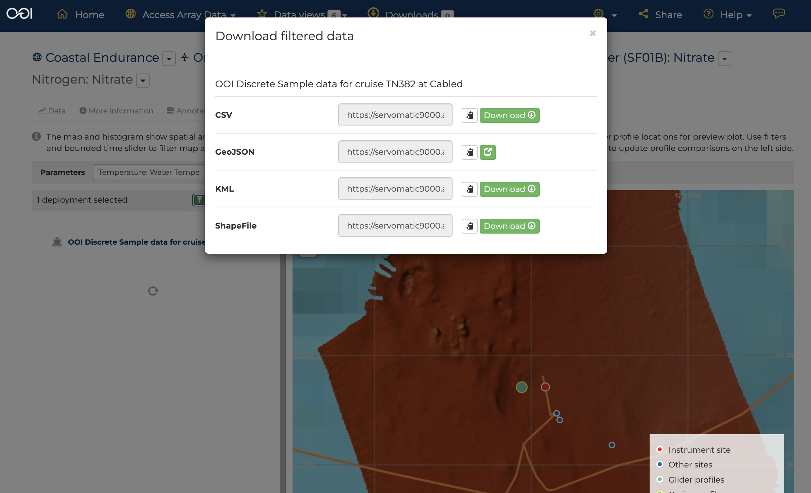
dataexplorer.oceanobservatories.org/#metadata/103775/station/124/sensor/profile_search?start=2020-02-23T07:11:43Z&end=2022-03-05T21:47:00Z
Click on the ‘Download’ button to the right on the csv line.
Name of file downloaded:
f8e4f1f5-b978-5fd9-ad4f-b7f73d2cf2b4.csv

Slide 22
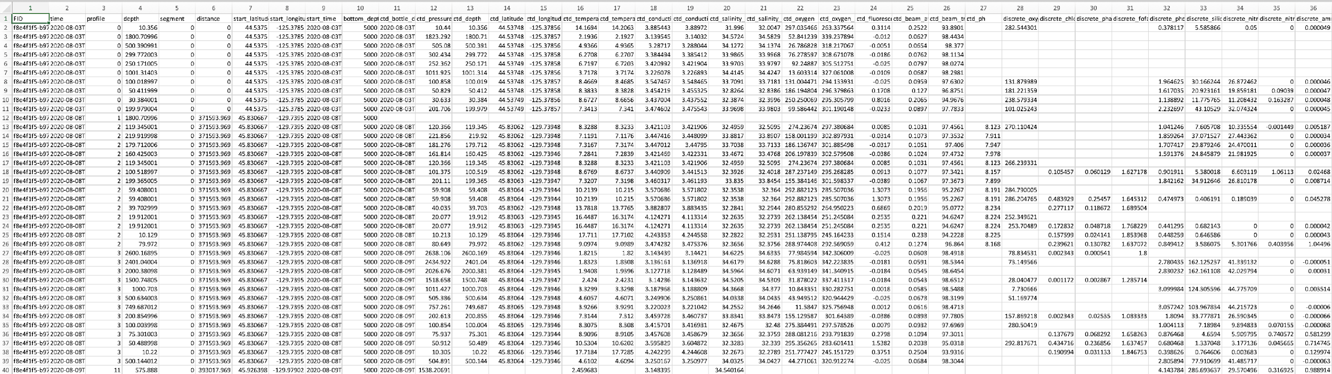
Bottle File data set
The file name corresponds to the FID in the first column of the data:
f8e4f1f5-b978-5fd9-ad4f-b7f73d2cf2b4.1
Also note that leaving the parameters selection on the default ‘temperature’ yield the entire bottle sample data set. Nitrate is in column 34 in this example.

